Slide 1
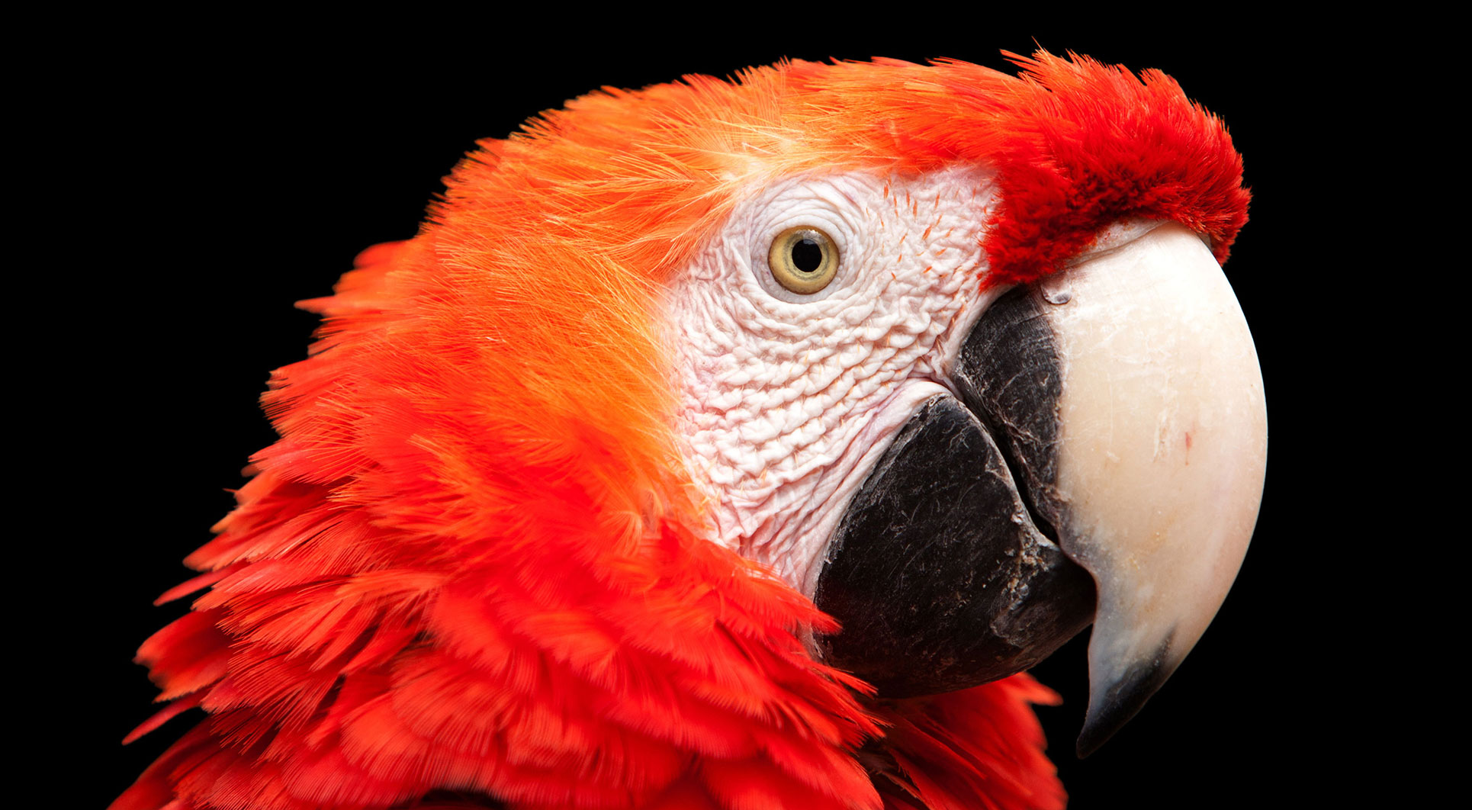
2.5 迷宫的N个门选择：If …elif…
《Python青少年趣味编程》
小牛叔出品

Slide 2
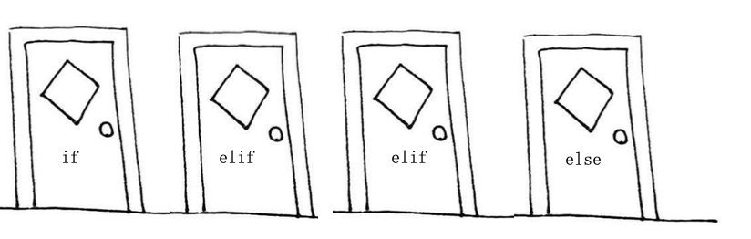
多条件分支图示

Slide 3
翻译中文数字
number = input("输入中文一至九：")
output = ''
if number == "一":
output = '1'
elif number == "二":
output='2'
elif number == "三":
output='3'
elif number == "四":
output='4'
elif number == "五":
output='5'
elif number == "六":
output='6'
elif number == "七":
output='7'
elif number == "八":
output='8'
elif number == "九":
output='9'
else:
output='输入错误'
print(output)

